Slide 1
Getting Git
Jason Bock

Slide 2
Personal Info
http://www.jasonbock.net
https://www.twitter.com/jasonbock
https://www.github.com/jasonbock
jason.r.bock@outlook.com

Slide 3
Downloads
https://github.com/JasonBock/Presentations/
blob/master/Getting%20Git.pptx

Slide 4
Overview
Definitions
Demos
Remember….
https://github.com/JasonBock/Presentations/blob/master/Getting%20Git.pptx

Slide 5

Definitions
What is
?
https://git-scm.com/images/logos/downloads/Git-Icon-1788C.png
Notes:
So, to start, what exactly is Git?

Slide 6
Definitions
Branching and Merging
Small and Fast
Distributed
Data Assurance
Staging Area
Free and Open Source
https://git-scm.com/about
Notes:
Here are the main “selling” points for Git. Let’s drill down into a couple of them.

Slide 7

Definitions
Branching and Merging
https://git-scm.com/about/branching-and-merging
Notes:
Frictionless Context Switching. Create a branch to try out an idea, commit a few times, switch back to where you branched from, apply a patch, switch back to where you are experimenting, and merge it in.
Role-Based Codelines. Have a branch that always contains only what goes to production, another that you merge work into for testing, and several smaller ones for day to day work.
Feature Based Workflow. Create new branches for each new feature you're working on so you can seamlessly switch back and forth between them, then delete each branch when that feature gets merged into your main line.
Disposable Experimentation. Create a branch to experiment in, realize it's not going to work, and just delete it - abandoning the work—with nobody else ever seeing it (even if you've pushed other branches in the meantime).

Slide 8
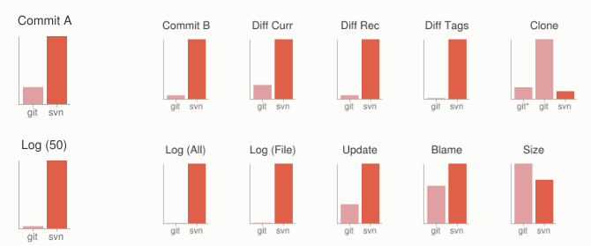
Definitions
Small and Fast
https://git-scm.com/about/small-and-fast
Notes:
Git is fast. With Git, nearly all operations are performed locally, giving it a huge speed advantage on centralized systems that constantly have to communicate with a server somewhere.
Git was built to work on the Linux kernel, meaning that it has had to effectively handle large repositories from day one. Git is written in C, reducing the overhead of runtimes associated with higher-level languages. Speed and performance has been a primary design goal of the Git from the start.
Clearly, in many of these common version control operations, Git is one or two orders of magnitude faster than SVN, even under ideal conditions for SVN.
One place where Git is slower is in the initial clone operation. Here, Git is downloading the entire history rather than only the latest version. As seen in the above charts, it's not considerably slower for an operation that is only performed once.

Slide 9
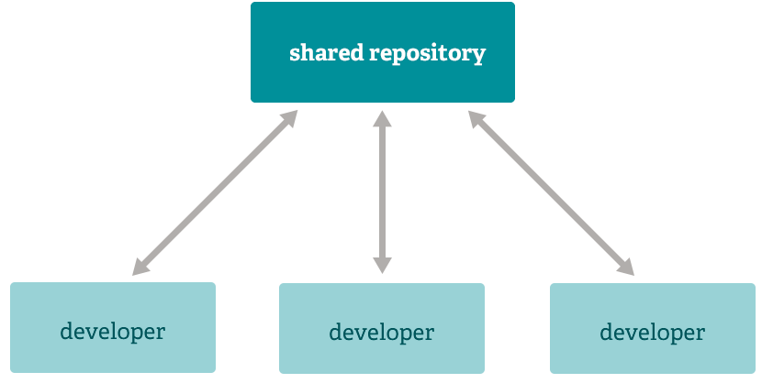
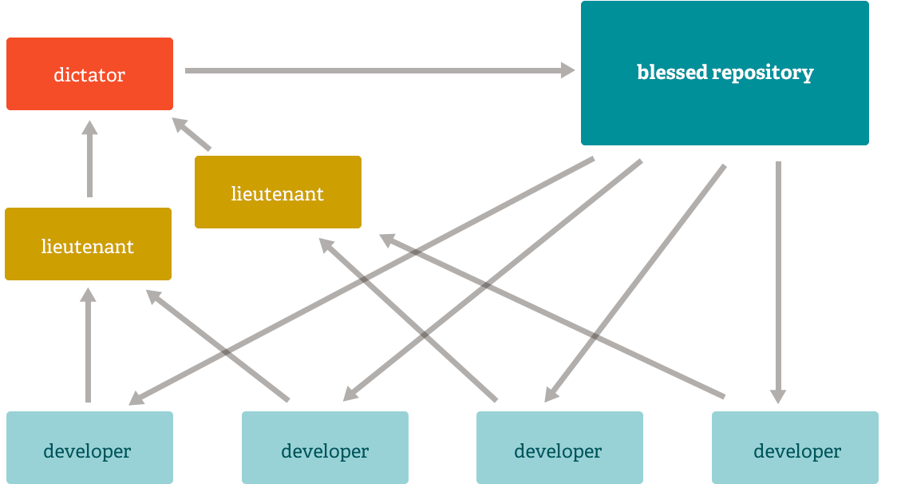
Definitions
Distributed
https://git-scm.com/about/branching-and-merging
Notes:
Multiple Backups - This means that even if you're using a centralized workflow, every user essentially has a full backup of the main server. Each of these copies could be pushed up to replace the main server in the event of a crash or corruption. In effect, there is no single point of failure with Git unless there is only a single copy of the repository.
Any Workflow - Because of Git's distributed nature and superb branching system, an almost endless number of workflows can be implemented with relative ease.
Subversion-Style Workflow - A centralized workflow is very common, especially from people transitioning from a centralized system. Git will not allow you to push if someone has pushed since the last time you fetched, so a centralized model where all developers push to the same server works just fine.
Dictator and Lieutenants Workflow - For more massive projects, a development workflow like that of the Linux kernel is often effective. In this model, some people ('lieutenants') are in charge of a specific subsystem of the project and they merge in all changes related to that subsystem. Another integrator (the 'dictator') can pull changes from only his/her lieutenants and then push to the 'blessed' repository that everyone then clones from again.

Slide 10
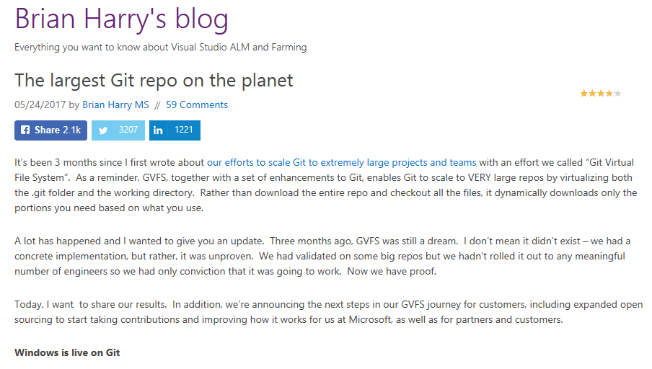
Definitions
Windows is live on Git
https://blogs.msdn.microsoft.com/bharry/2017/05/24/the-largest-git-repo-on-the-planet/
Notes:
Also, it’s extremely interesting that the Windows source code base is now hosted in a Git repo. Used to be on something called SourceDepot, but they’ve moved to Git.

Slide 11

Definitions
.NET Compiler Platform ("Roslyn")
.NET Core
ASP.NET Core
ASP.NET SignalR
BenchmarkDotNet
Cake
And a lot more!
https://dotnetfoundation.org/
Notes:
Micorsoft has changed its tune on open source. A lot of their frameworks and packages, along with other community-backed projects, are now hosted on GitHub. Speaking of GitHub….

Slide 12
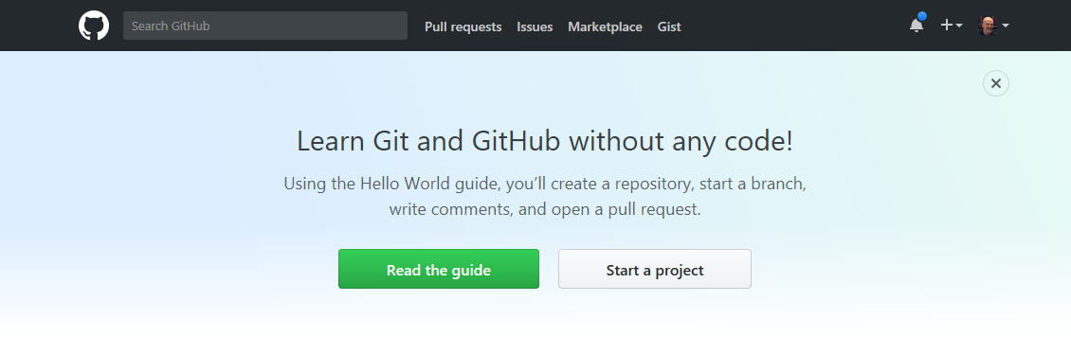
Definitions
https://github.com/
Notes:
GitHub is a provider of public (and private) Git repositories.

Slide 13

Definitions
!=
Notes:
Keep in mind that Git does not mean “I’m hosting on GitHub”.

Slide 14
Demo: Basic Git Concepts
Getting Git
Notes:
Let’s create a simple .NET Core Hello World app that’s stored in a local Git repo

Slide 15
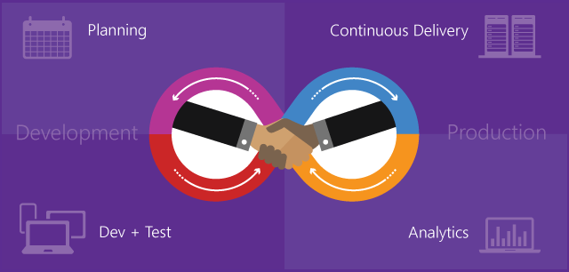
Definitions
https://www.visualstudio.com/en-us/docs/devops-alm-overview
Notes:
Now, TFS is a product that encompasses a lot of the development and project lifecycle. Part of that is source control. TFS was originally equated with source control, but the world has changed….

Slide 16
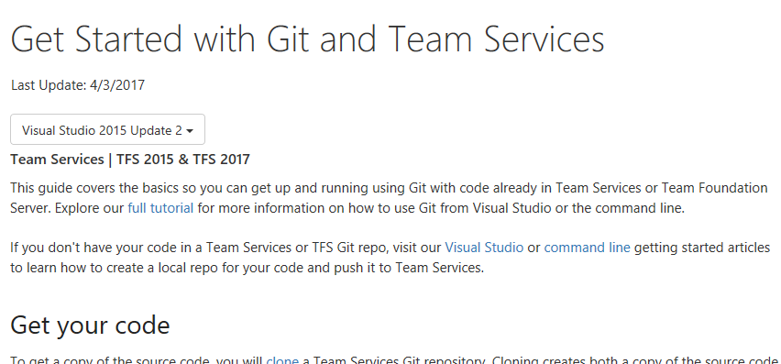
Definitions
https://www.visualstudio.com/en-us/docs/git/gitquickstart
Notes:
You can now use a Git repo with a TFS project

Slide 17
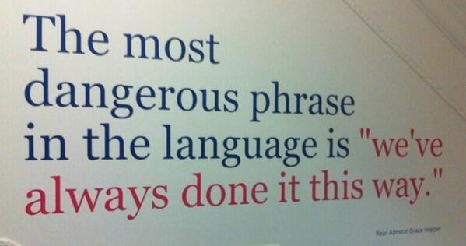
Definitions
https://www.visualstudio.com/en-us/docs/git/gitquickstart
Notes:
Now, some people just don’t want to move to Git. Change for change’s sake isn’t a good thing, but….well, that phrase sums it up.

Slide 18
Definitions
Merge times
Pull requests
Interactive rebase (== TFS changeset)
Parallel branch work
Git rebases
Three-way merges (less conflicts)
No checkouts (!!!!)
Offline work
http://www.continuousimprover.com/2015/06/why-you-should-abandon-tfs-source.html
Notes:
Here’s an article that talks about some specific advantages with Git.
Merge times are much smaller.
No checkouts (yes, TFSVC doesn’t make that required, but…)
Less conflicts, I’ve seen that myself

Slide 19
Demo: Using Git in TFS
Getting Git
Notes:
Let’s see how one can use Git in TFS along with Visual Studio via the MyVote repository.

Slide 20

Conclusion
=
Notes:
Git = LOVE!

Slide 21
Getting Git
Jason Bock
Remember…
https://github.com/JasonBock/Presentations/blob/master/Getting%20Git.pptx
References in the notes on this slide
Notes:
Tips for enterprises migrating or adopting Git - https://blogs.msdn.microsoft.com/premier_developer/2018/03/20/tips-for-enterprises-migrating-or-adopting-git/
Roslyn on GitHub - https://www.slideshare.net/terrajobst/roslyn-on-git-hub
Microsoft’s Performance Contributions to Git in 2017 - https://blogs.msdn.microsoft.com/devops/2018/01/11/microsofts-performance-contributions-to-git-in-2017/
GitHub Flow Like a Pro with these 13 Git Aliases - https://haacked.com/archive/2014/07/28/github-flow-aliases/
Trunk-Based Development or Pull Requests - Why Not Both? - https://jimmybogard.com/trunk-based-development-or-pull-requests-why-not-both/
GitHub Cheat Sheet - https://github.com/tiimgreen/github-cheat-sheet
Create a new Git repo in your project - https://docs.microsoft.com/en-us/vsts/git/create-new-repo
A successful Git branching model - http://nvie.com/posts/a-successful-git-branching-model/
Using Git and GitHub - https://www.youtube.com/watch?v=8olbR_Xtg2Q
Pro Git - https://git-scm.com/book/en/v2
Visual Studio Toolbox: Git Fundamentals - https://blogs.msdn.microsoft.com/robertgreen/2017/08/01/visual-studio-toolbox-git-fundamentals/
Git - https://git-scm.com/
Git Fundamentals - https://www.pluralsight.com/courses/git-fundamentals
Why you should abandon TFS and adopt Git - http://www.continuousimprover.com/2015/06/why-you-should-abandon-tfs-source.html
Get Started with Git and Team Services - https://www.visualstudio.com/en-us/docs/git/gitquickstart
The largest Git repo on the planet - https://blogs.msdn.microsoft.com/bharry/2017/05/24/the-largest-git-repo-on-the-planet/
Git Virtual File System - https://github.com/Microsoft/gvfs
.NET Foundation - https://dotnetfoundation.org/
GitHub - https://github.com/
Feature Branches And Toggles In A Post-GitHub World - Sam Newman - https://www.youtube.com/watch?v=7qTOdbUAqno
More Time with Git at the Command Line
Setup - https://geoffhudik.com/tech/2017/07/19/git-command-line-part-1/
Getting Latest and Making Changes - https://geoffhudik.com/tech/2017/07/19/git-command-line-part-2/
Pushing, Fetching, and Viewing History - https://geoffhudik.com/tech/2017/07/19/git-command-line-part-3/
Merging and Managing Branches - https://geoffhudik.com/tech/2017/07/19/git-command-line-part-4/
Stashes and Reverting Work - https://geoffhudik.com/tech/2017/07/19/git-command-line-part-5/
Miscellaneous / Wrap-up - https://geoffhudik.com/tech/2017/07/19/git-command-line-part-6/
How to Write a Git Commit Message - https://chris.beams.io/posts/git-commit/
Git and Visual Studio 2017
Part 1 - https://blogs.msdn.microsoft.com/kenakamu/2017/09/28/git-and-visual-studio-2017-part-1/
Part 2 - https://blogs.msdn.microsoft.com/kenakamu/2017/09/28/git-and-visual-studio-2017-part-2/
Part 3 - https://blogs.msdn.microsoft.com/kenakamu/2017/09/29/git-and-visual-studio-2017-part-3/
Part 4 - https://blogs.msdn.microsoft.com/kenakamu/2017/09/29/git-and-visual-studio-2017-part-4/
Part 5 - https://blogs.msdn.microsoft.com/kenakamu/2017/09/29/git-and-visual-studio-2017-part-5/
Part 6 - https://blogs.msdn.microsoft.com/kenakamu/2017/09/29/git-and-visual-studio-2017-part-6/
Part 7 - https://blogs.msdn.microsoft.com/kenakamu/2017/09/29/git-and-visual-studio-2017-part-7/
Part 8 - https://blogs.msdn.microsoft.com/kenakamu/2017/09/29/git-and-visual-studio-2017-part-8/
Part 9 - https://blogs.msdn.microsoft.com/kenakamu/2017/09/29/git-and-visual-studio-2017-part-9/
Part 10 - https://blogs.msdn.microsoft.com/kenakamu/2017/09/29/git-and-visual-studio-2017-part-10/
Part 11 - https://blogs.msdn.microsoft.com/kenakamu/2017/09/29/git-and-visual-studio-2017-part-11/
Part 12 - https://blogs.msdn.microsoft.com/kenakamu/2017/09/29/git-and-visual-studio-2017-part-12/
Part 13 - https://blogs.msdn.microsoft.com/kenakamu/2017/09/29/git-and-visual-studio-2017-part-13/
Part 14 - https://blogs.msdn.microsoft.com/kenakamu/2017/09/29/git-and-visual-studio-2017-part-14/
Part 15 - https://blogs.msdn.microsoft.com/kenakamu/2017/09/29/git-and-visual-studio-2017-part-15/

